Slide 1

QUIZLOBBY
A Revolutionary Way To Educate

Slide 2


Slide 3

Introduction
QuizLobby is a web-based online educational platform which allows us not only to create quizzes but also to attempt them online. It is specially designed for educational institutes and also for the organizations that would like to hire new employees.

Slide 4

What’s Our Motivation?

Slide 5
THE PROBLEM
Due to covid-19, educational institutes went under lockdown and conducting quizzes became a hassle. Most of the students started taking their studies lightly and some started to lag behind as the teachers couldn't assess them or see where they stand.
For the teachers, checking so many quizzes becomes a huge and a difficult task.

Slide 6
THE SOLUTION
With QuizLobby, the teachers can easily create quizzes online, save them, and assign them to the students of the particular course. The students then, can easily attempt the quizzes online within the Given time.
Also, this website has an automatic checker to make teachers’ lives easier.

Slide 7

OUR MISSION
To contribute to the digital era - make online classes beneficial
To help teachers - make their job easier with online quiz creation and automatic checker
To help students - allow them to attempt quizzes honestly and see where they stand
To contribute in saving the planet - paperless quizzes

Slide 8
Sneak Peak

Slide 9

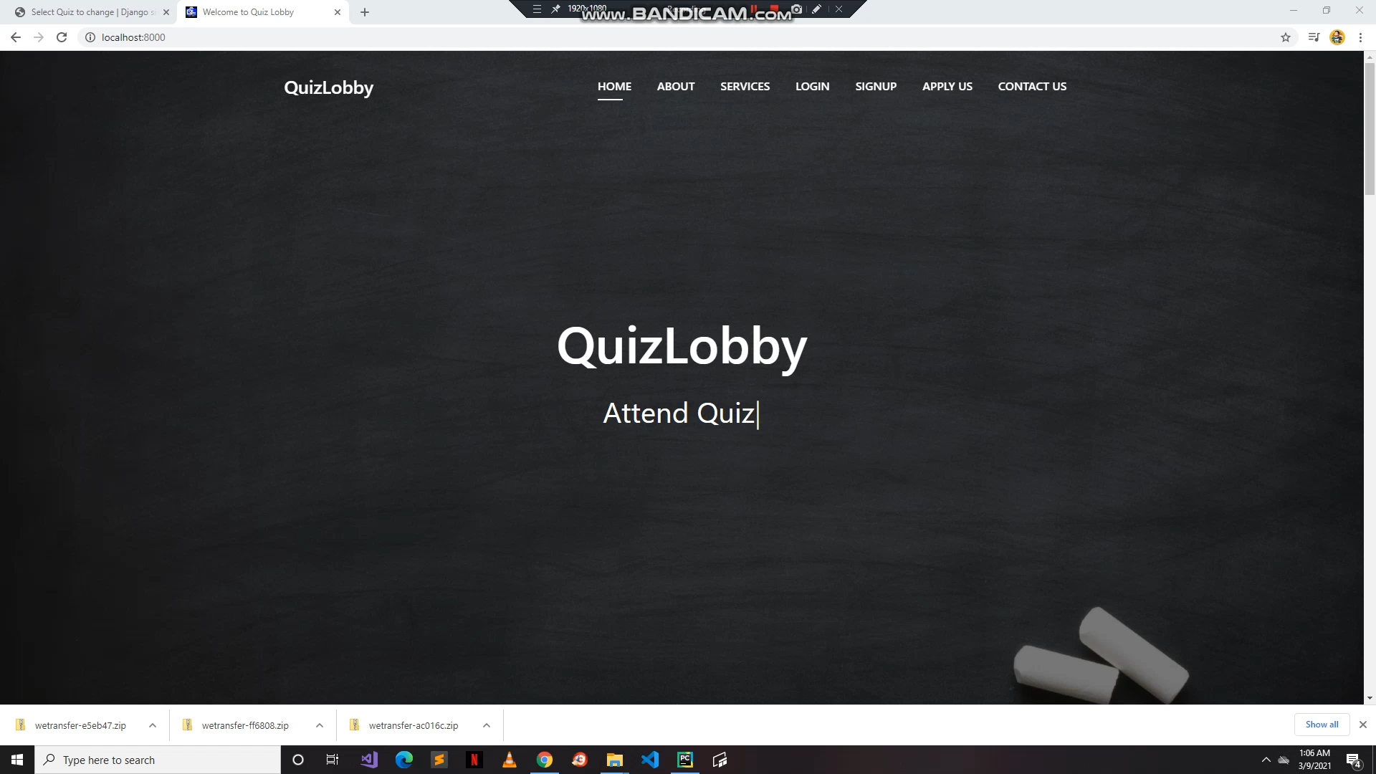
Signup & Course Enrolment

Slide 10
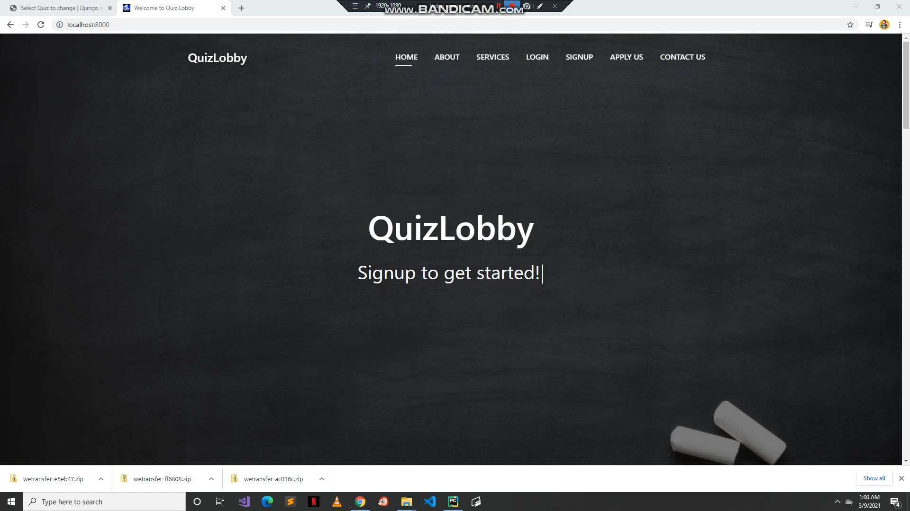
Login & Attend Quiz

Slide 11
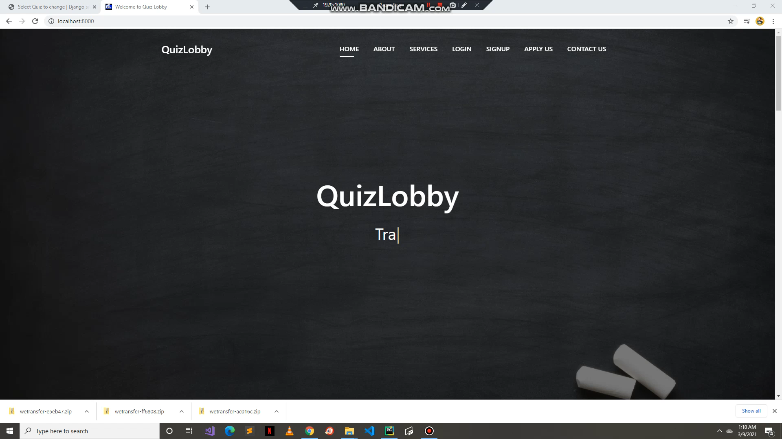
Teacher Application Form

Slide 12
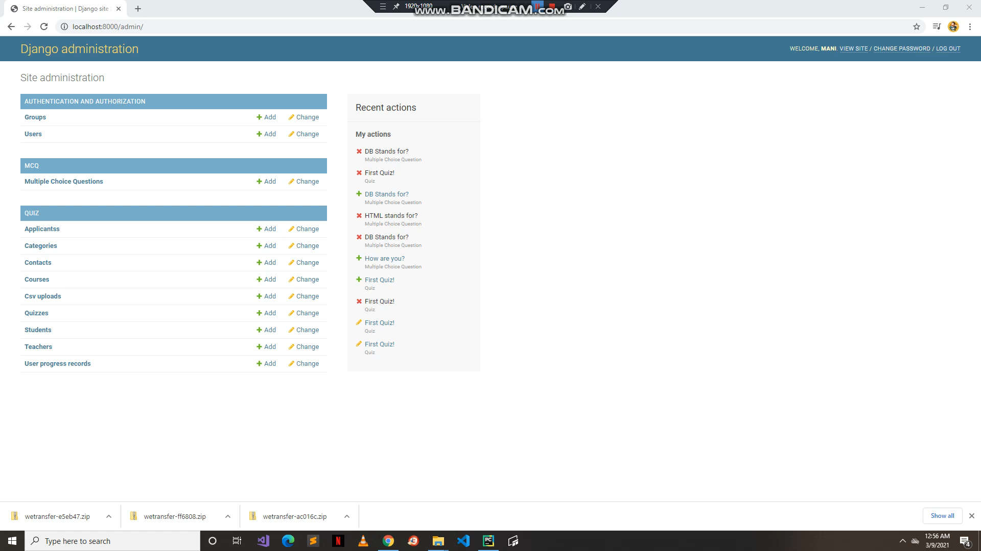
Add Questions

Slide 13

Create Quiz

Slide 14
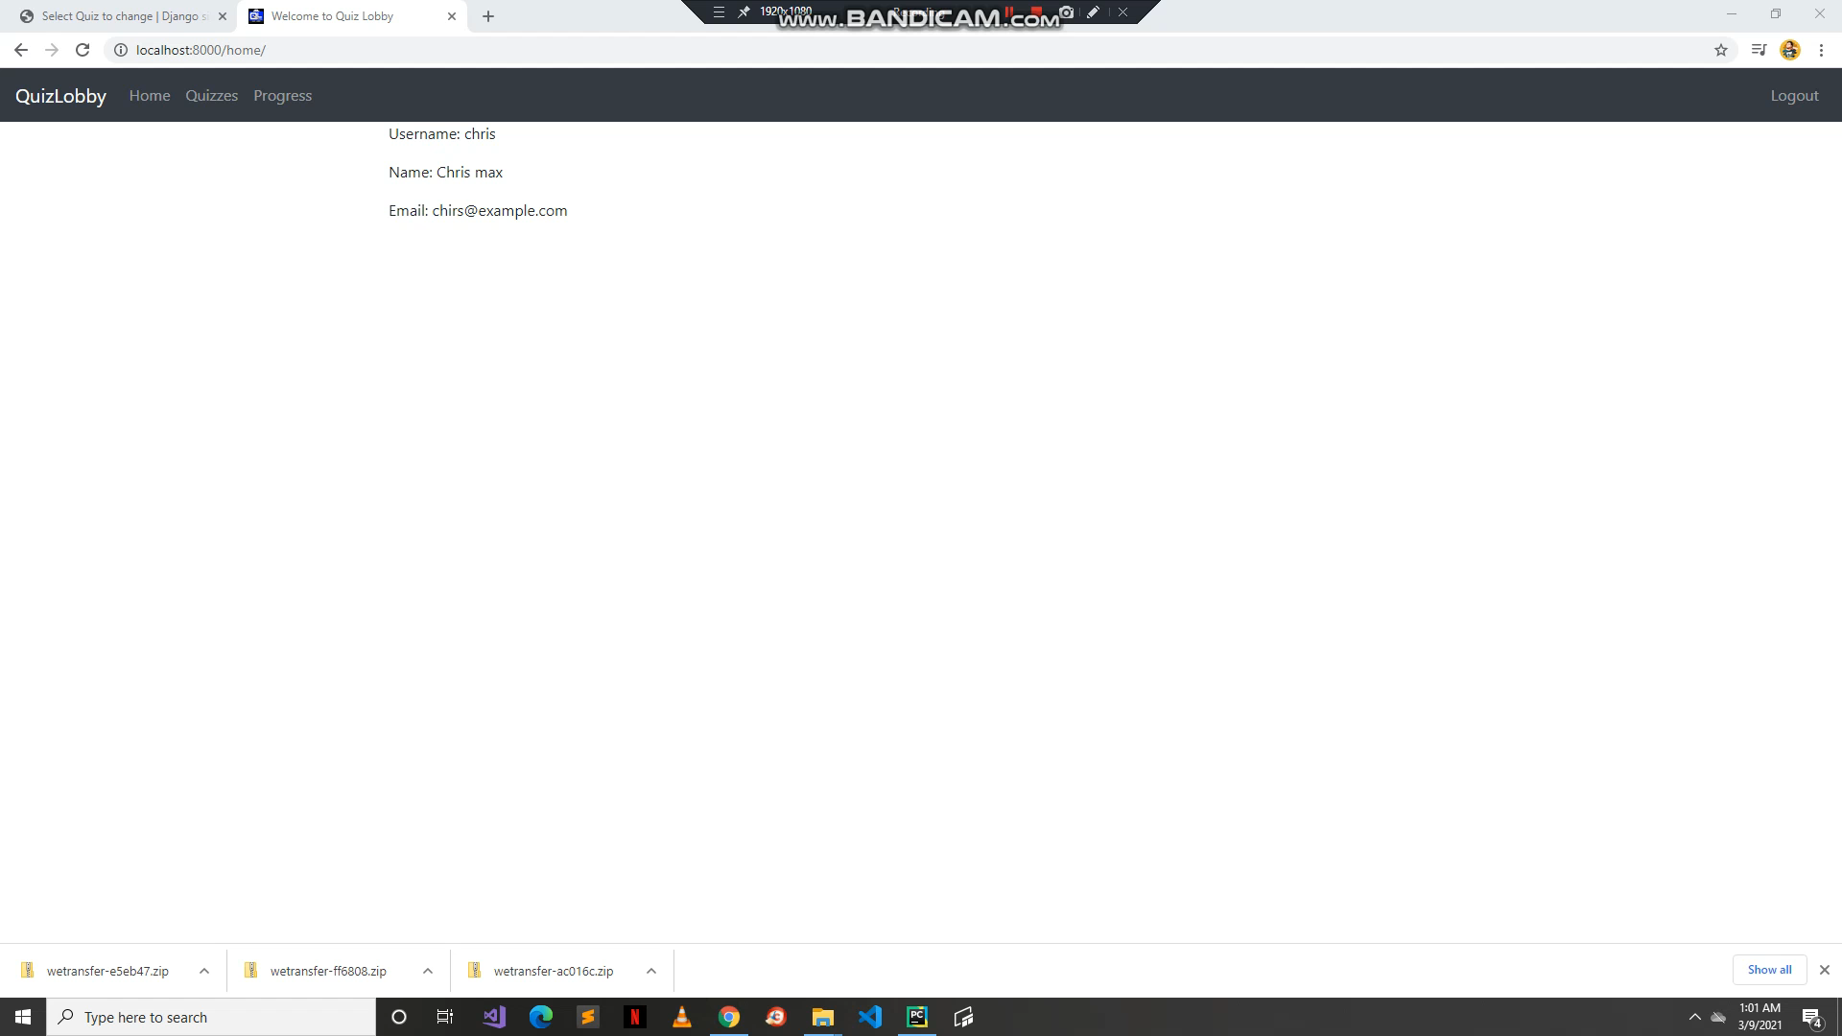
Progress Check

Slide 15
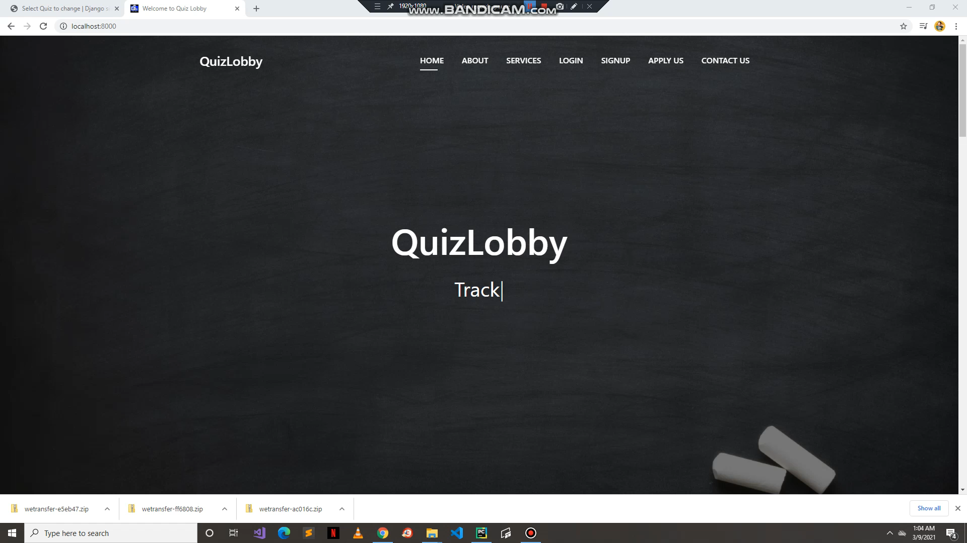
Contact Us

Slide 16
Tools & Technology:
HTML5
CSS3
Bootstrap4
JavaScript
Adobe Photoshop
Python
Django
Creately

Slide 17
Future Work:
Add features to minimize/end plagiarism
Shuffled Mcqs
Copy/Paste option disabled
Unable to minimize window
Add different types of questions
Picture questions, long/short questions
Add feature to close window when quiz time ends
Aim is to spread it globally
Introduce subscription packages
Make it user friendly and interactive

Slide 18


